Slide 1
Introduction to Bioinformatics
Ananta Acharya

Slide 2
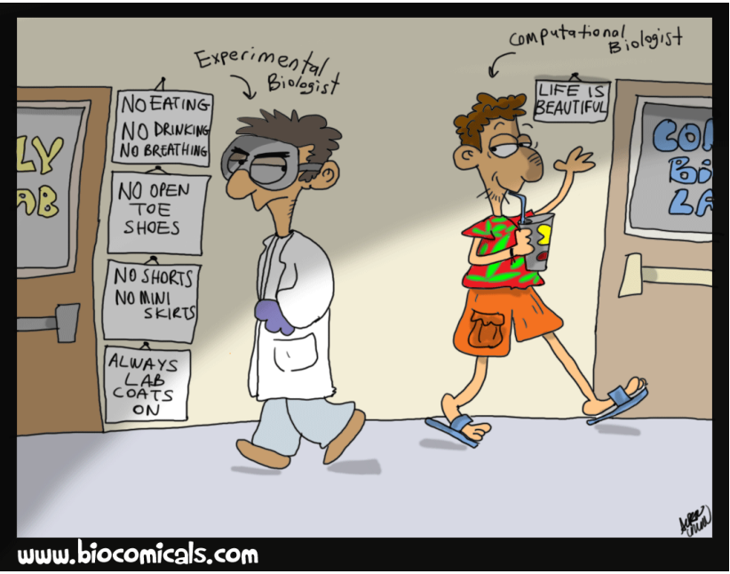

Slide 3
What is bioinformatics
Bioinformatics is a hybrid of biology and computer science
Bioinformatics is the application of computers to the collection, archiving, organization, and analysis of biological data

Slide 4
Scope and application
• Organization, classification, dissemination and analysis of biological data
Genome, transcriptome, proteome, metabolome
• Biological sequence analysis and phylogenetics
• Genome organization and evolution
• Regulation of gene expression and epigenetics
• Biological pathways and networks
• Protein structure prediction from sequence

Slide 5
Beware!
“Think about what you’re doing; use your knowledge of the molecular system involved to guide both your interpretation of results and your direction of inquiry; use as much information as possible; and do not blindly accept everything the computer offers you”.
Gunnar von Heijne

Slide 6
What bioinformatician do?
Usually we work with Unix compatible shells, logging remotely to high performance computing clusters to perform analysis of biological datasets.
We program (a little bit of a lot, depending on which side we stand). Computer scientist are usually focused on developing novel algorithms, or optimizing existing ones. From the biological side (where I come from) we focus on getting results from data applying for the most existing tools.
We check forums and google a lot
We talk with scientists because often we are part of big projects involving them. Half of the time we spend together is to try understanding each other :)
We perform literature check to see what's going on, we look for meetings and symposia that we would like to join

Slide 7
Revision of molecular biology
..\..\..\..\OneDrive\rampur binf\intro to molecular biology.pdf

Slide 8
Sequencing Technologies
https://modmedmicro.nsms.ox.ac.uk/the-dna-sequencing-technologies-we-use/
First Generation:
Sanger
2nd generation, Nexte generation sequencing
Illumina (454,solid now obsolete)
3rd generation
Pacbio, Bionano

Slide 9
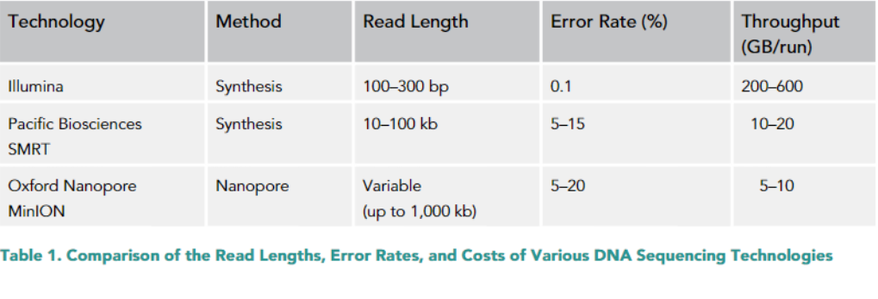

Slide 10
Data formats
-fasta
-fastq
-sam/bam
-vcf
-gff
-genbank
https://bioinformatics-core-shared-training.github.io/intro-to-IGV/fileFormats.pdf

Slide 11
Online resources
NCBI (https://www.ncbi.nlm.nih.gov/)
NCBI blast (https://blast.ncbi.nlm.nih.gov/Blast.cgi)
EBI (https://www.ebi.ac.uk/)

